Slide 1
Solving Tower of Hanoi using Deep Q-Learning
Sophia Damilola Lawal 310882

Slide 2
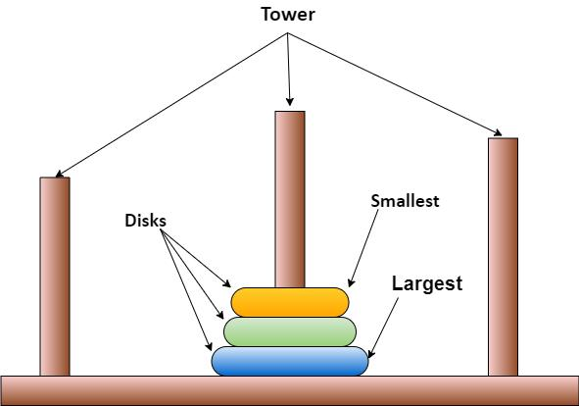
Introduction
Source tower
Given three towers (Source, helper and destination), and a number of disks with different sizes.
At the initial state of the puzzle, the source tower is stacked with n disks of varying sizes; the largest disk is at the tower’s base and the smallest disk is at the top.
The goal of the puzzle is to move the entire stack from the source tower to the destination tower using the least amount of moves according to these rules:
Only one disk can be moved at a time
No disk may be placed on top of a smaller disk
Tower of Hanoi puzzle was proposed in 1883 by French mathematician E. Lucas
Destination tower
Helper Tower
Source:stechies
Ryuhei Uehara. 2019. Recursive call. In First Course in Algorithms Through Puzzles, Ryuhei Uehara (ed.). Springer, Singapore, 43–55. DOI:https://doi.org/10.1007/978-981-13-3188-6_2
Source:viblo.asia

Slide 3
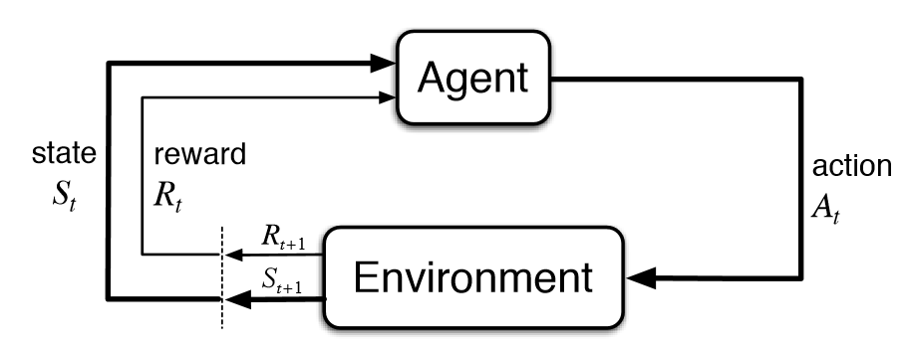
Problem Formulation - Reinforcement Learning
The current configuration of the rods and the disks represent the state of the system at any given time
The number of moves that the agent has made
The possible moves the agent can make
Goal: is to minimize the number of moves required by the agent to get to destination tower from source tower

Slide 4
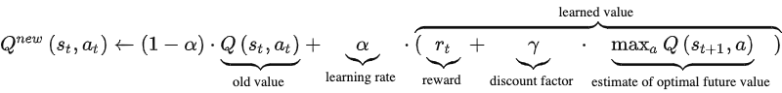
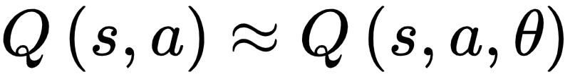
Deep Q-Learning
OFF POLICY TD(0) LEARNING OF THE QUALITY FUNCTION
Parameterize Q Function with Neural Network
Python Programming Tutorials. Retrieved January 4, 2023 from https://pythonprogramming.net/deep-q-learning-dqn-reinforcement-learning-python-tutorial/

Slide 5
Project Objectives
Environment: Create a reinforcement learning for the Tower of Hanoi puzzle using OpenAI gym
Model Architecture: Design a Quality Function architecture
Training: off policy training
Experiment
Solve the tower of Hanoi puzzle for n= 7 disks
Compare results with the following baseline:
Recursive Call
Random Solution
Q-Learning
Dataset
Agent’s experiences, which are represented as a sequence of states, actions and rewards it encountered during its interaction with the environment

Slide 6
Conclusion
This project aim to solve the Tower of Hanoi puzzle for n = 7 disks using deep Q-learning and compare with three baselines

Slide 7
References
[1] Shweta Bhatt. 2019. Reinforcement Learning 101. Medium. Retrieved January 4, 2023 from https://towardsdatascience.com/reinforcement-learning-101-e24b50e1d292
[2] Ryuhei Uehara. 2019. Recursive call. In First Course in Algorithms Through Puzzles, Ryuhei Uehara (ed.). Springer, Singapore, 43–55. DOI:https://doi.org/10.1007/978-981-13-3188-6_2
[3] Q-Learning By Examples: Tower of Hanoi Game. Retrieved January 4, 2023 from https://people.revoledu.com/kardi/tutorial/ReinforcementLearning/Tower-of-Hanoi-Game.htm
[4] How to Solve Tower of Hanoi in C? STechies. Retrieved January 4, 2023 from http://www.stechies.com/tower-of-hanoi-c/
[5] Python Programming Tutorials. Retrieved January 4, 2023 from https://pythonprogramming.net/deep-q-learning-dqn-reinforcement-learning-python-tutorial/

